Slide 1
ShanghaiTech University
EE 115B: Digital Circuits
Fall 2024
Lecture 5
Hengzhao Yang
October 15, 2024

Slide 2

Boolean Algebra and Logic Simplification
Boolean Algebra
Logic Simplification
  Karnaugh Map
  Quine-McCluskey Method
Prof. Yajun Ha

Slide 3
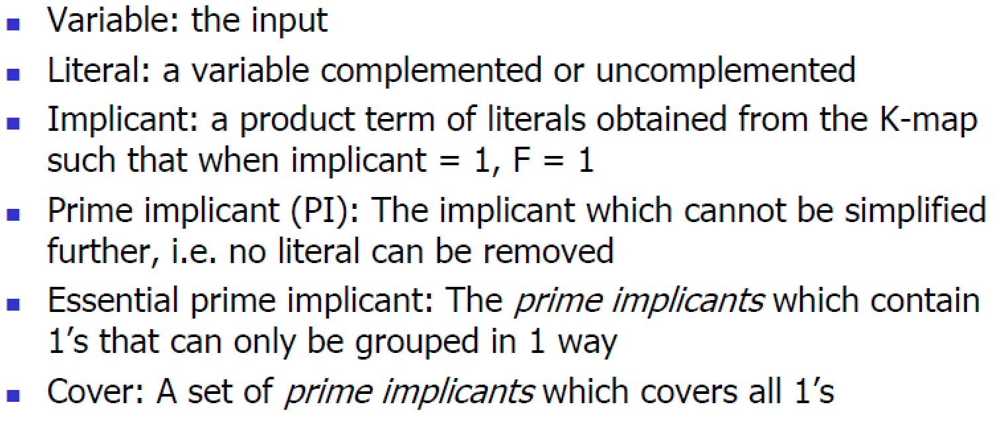
Terminology
Prof. Yajun Ha

Slide 4
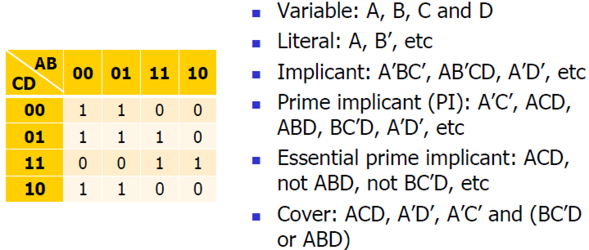
Terminology Example
Prof. Yajun Ha

Slide 5
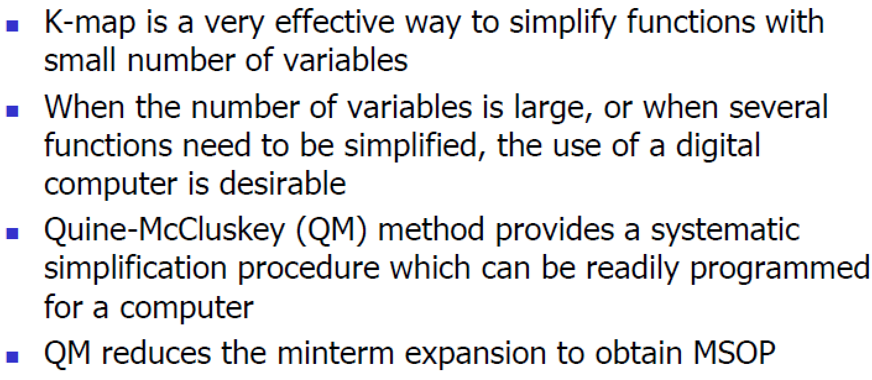
Limitations of K-Map
Prof. Yajun Ha

Slide 6
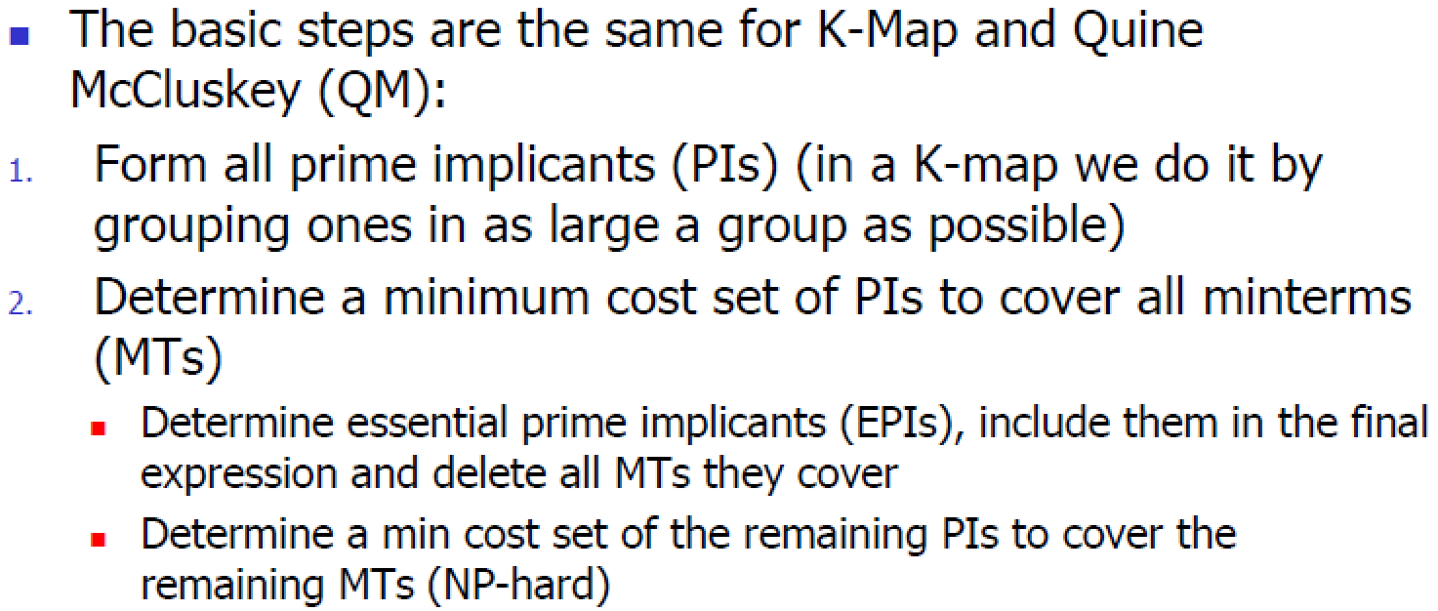
Basic Two-level QM Minimization Steps
Prof. Yajun Ha

Slide 7
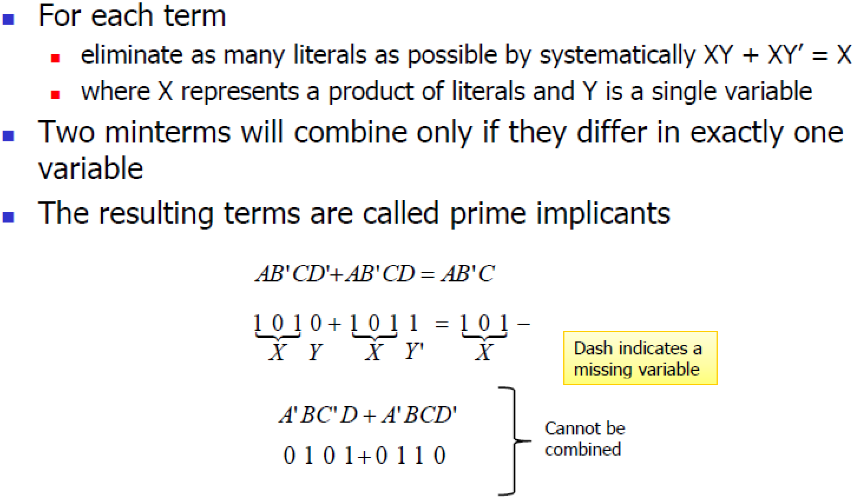
Determination of Prime Implicants
Prof. Yajun Ha

Slide 8
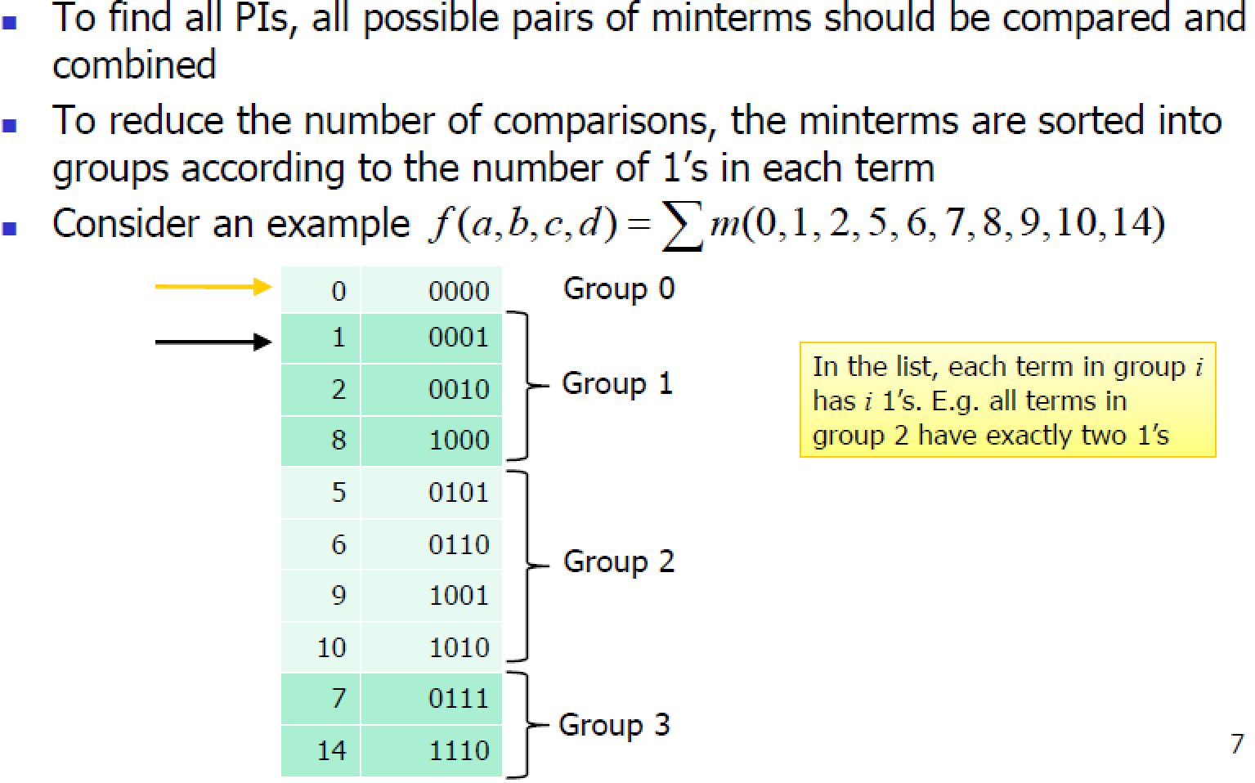
Determination of Prime Implicants
Prof. Yajun Ha

Slide 9
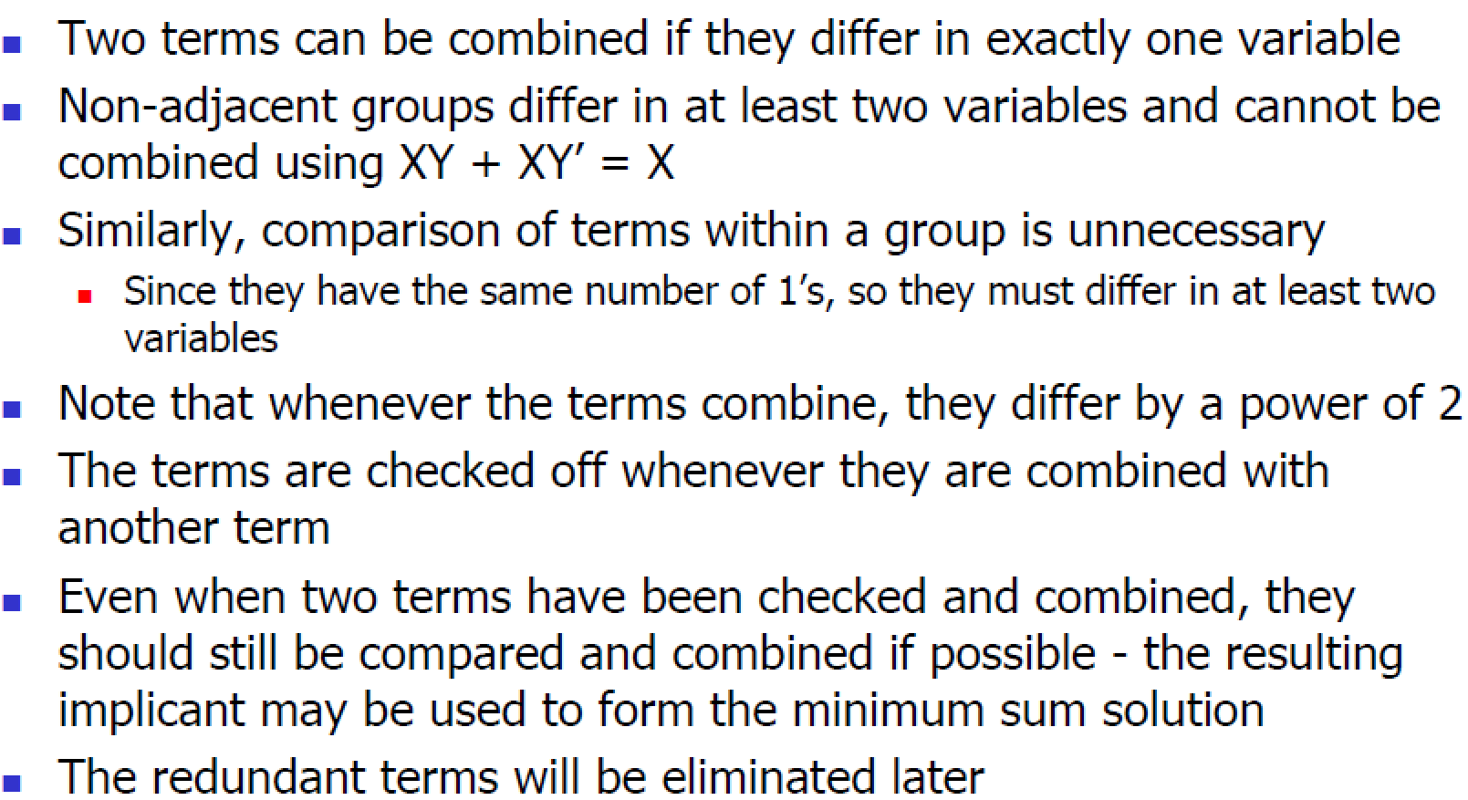
Determination of Prime Implicants
Prof. Yajun Ha

Slide 10
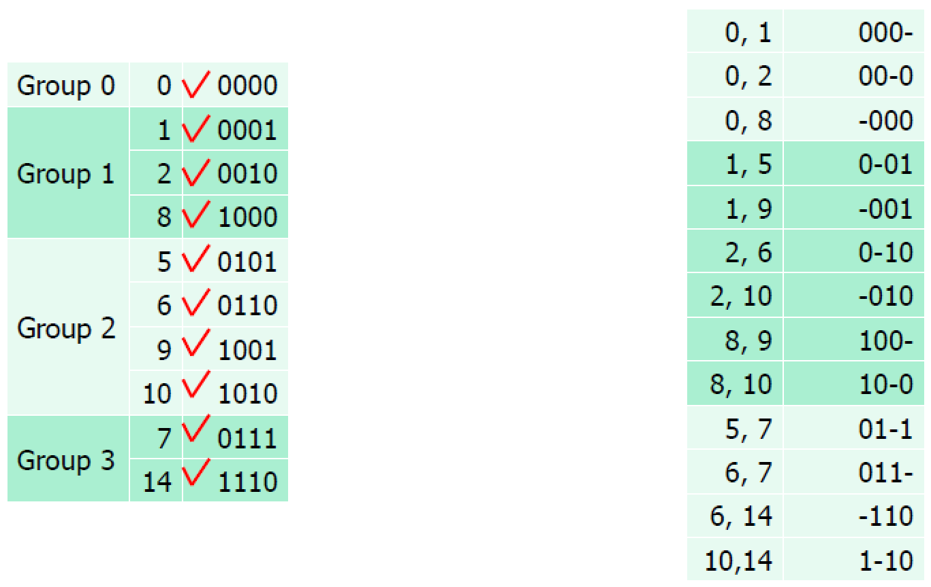
Determination of Prime Implicants
Prof. Yajun Ha

Slide 11
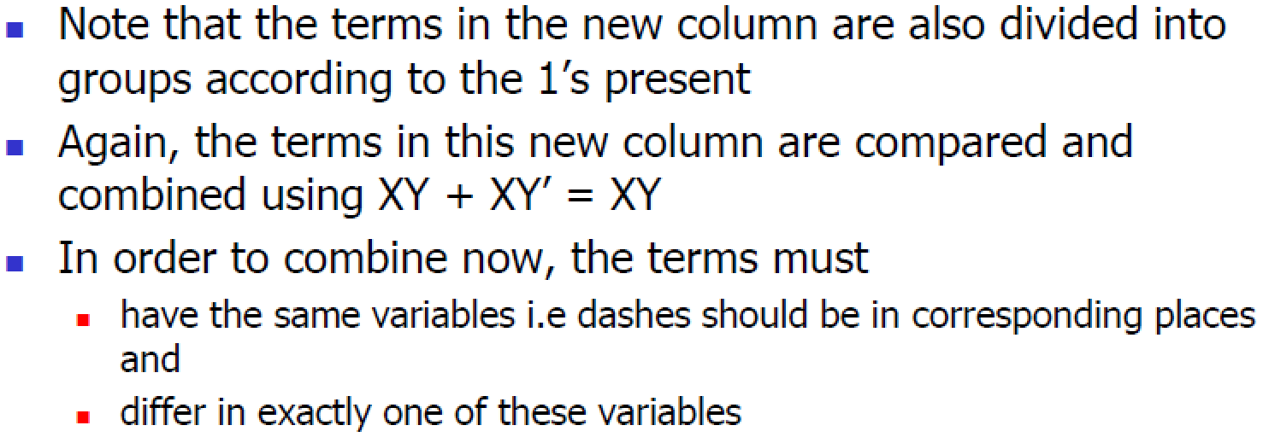
Determination of Prime Implicants
Prof. Yajun Ha

Slide 12
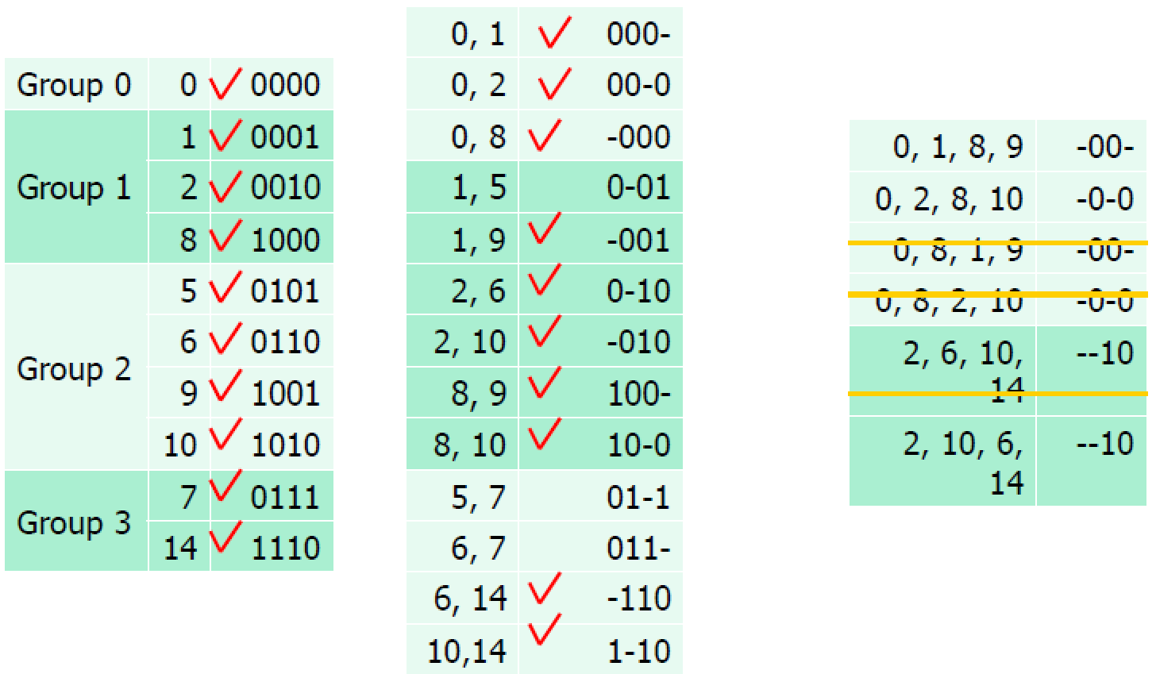
Determination of Prime Implicants
Prof. Yajun Ha

Slide 13
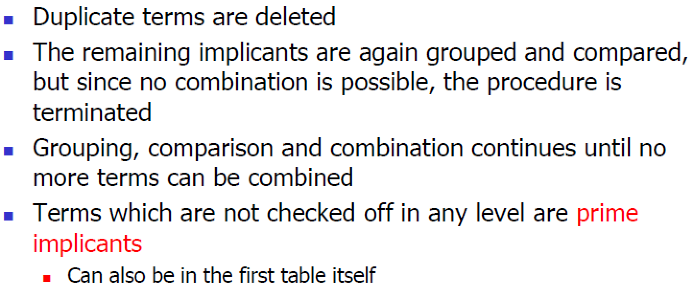
Determination of Prime Implicants
Prof. Yajun Ha

Slide 14
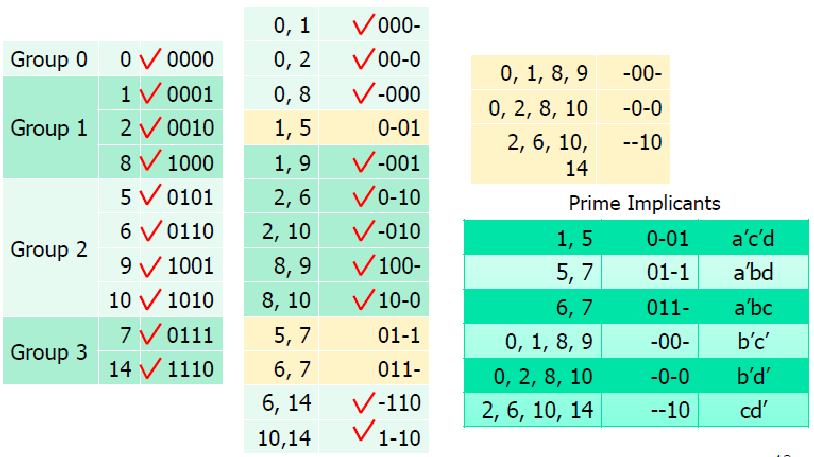
Prime Implicants
Prof. Yajun Ha

Slide 15
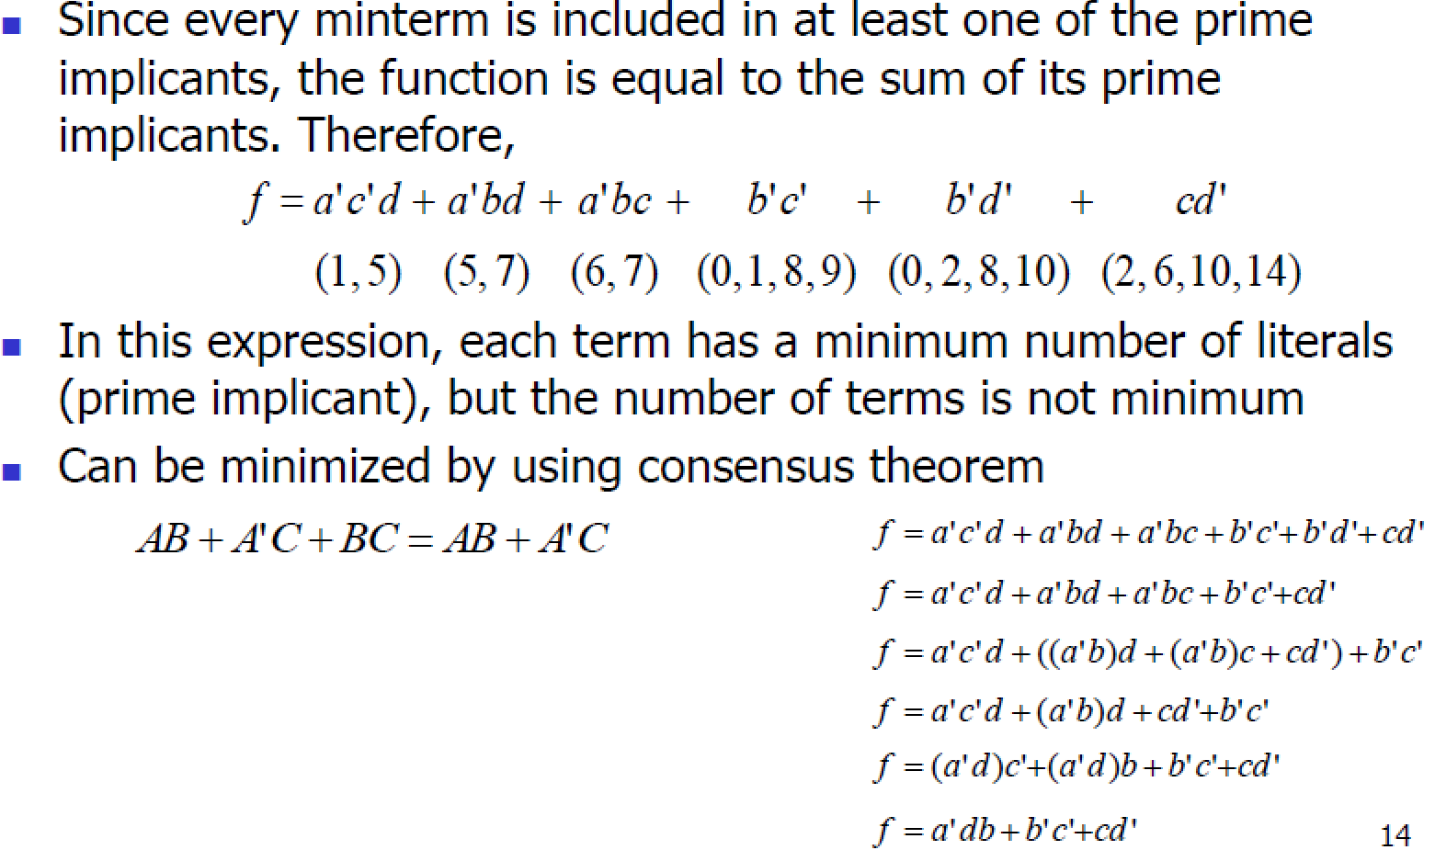
Prime Implicant Cover
Prof. Yajun Ha

Slide 16
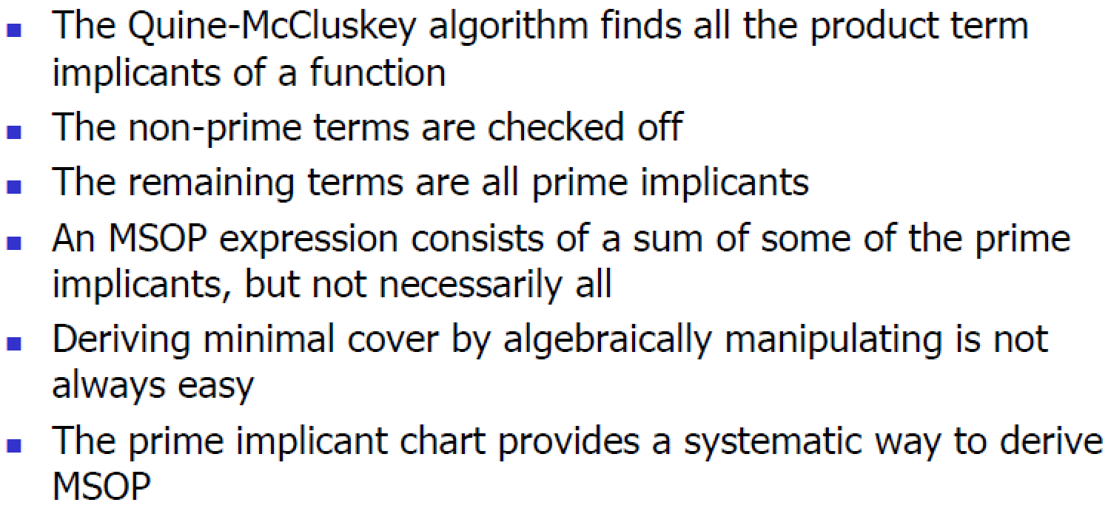
Prime Implicant Cover
Prof. Yajun Ha

Slide 17
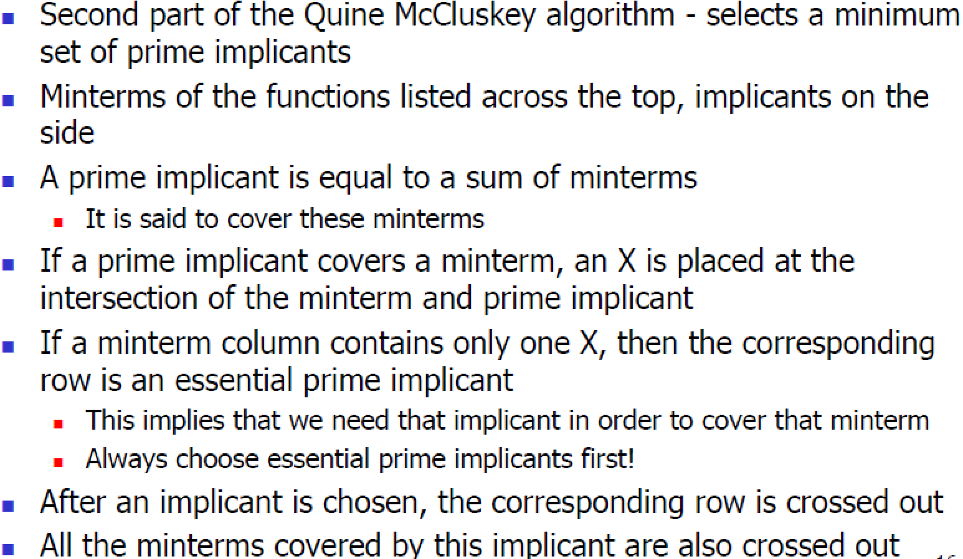
Prime Implicant Chart
Prof. Yajun Ha

Slide 18
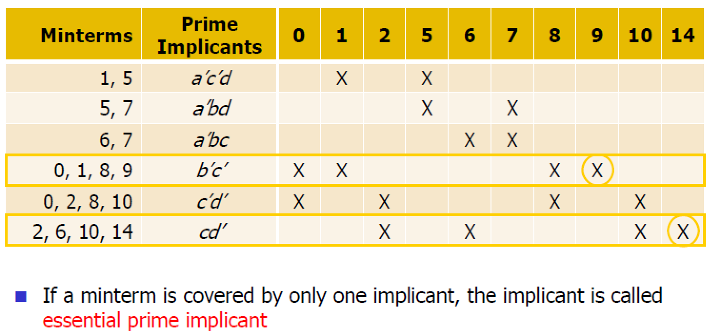
Prime Implicant Chart
Prof. Yajun Ha

Slide 19
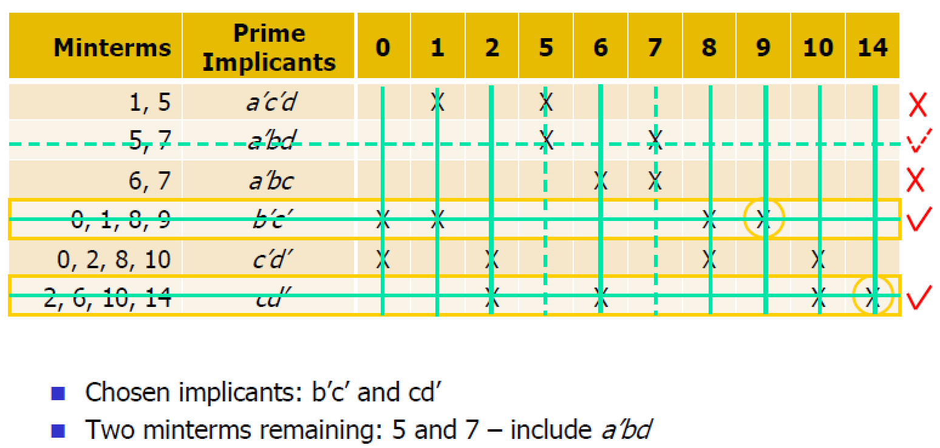
Prime Implicant Chart
Prof. Yajun Ha

Slide 20
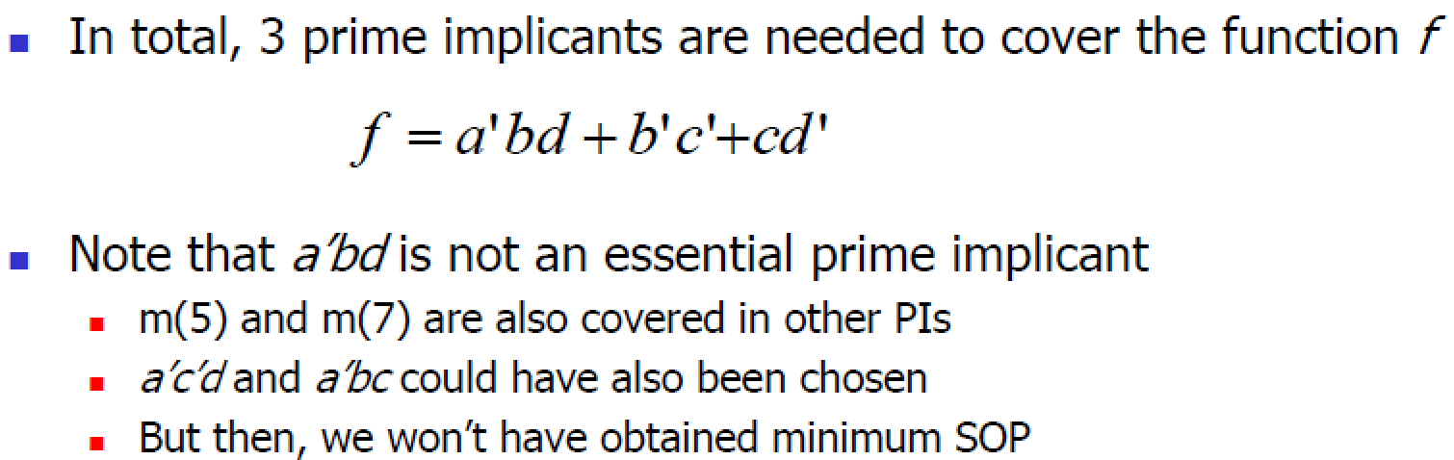
Minimal Cover
Prof. Yajun Ha

Slide 21
5
Combinational
Logic Analysis

Slide 22
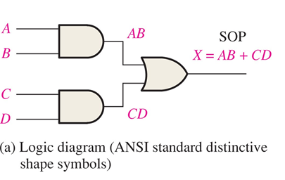
FIGURE 5-1 An example of AND-OR logic.
AND-OR logic for SOP expressions _______________________________________________

Slide 23
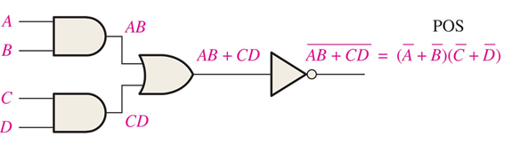
FIGURE 5-3 An AND-OR-Invert circuit produces a POS output.
AND-OR-Invert (AOI) logic for POS expressions _______________________________________________

Slide 24
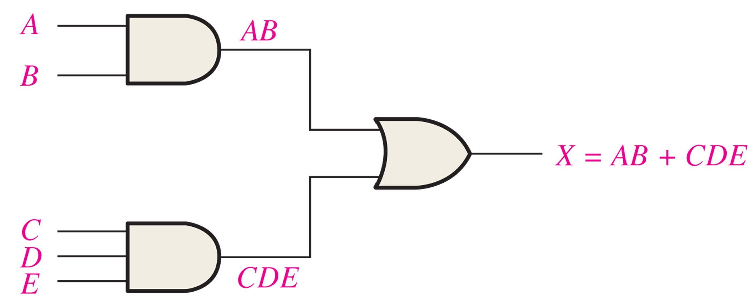
FIGURE 5-9 Logic circuit for X = AB + CDE.
Implementing combinational logic: From a Boolean expression
_______________________________________________

Slide 25
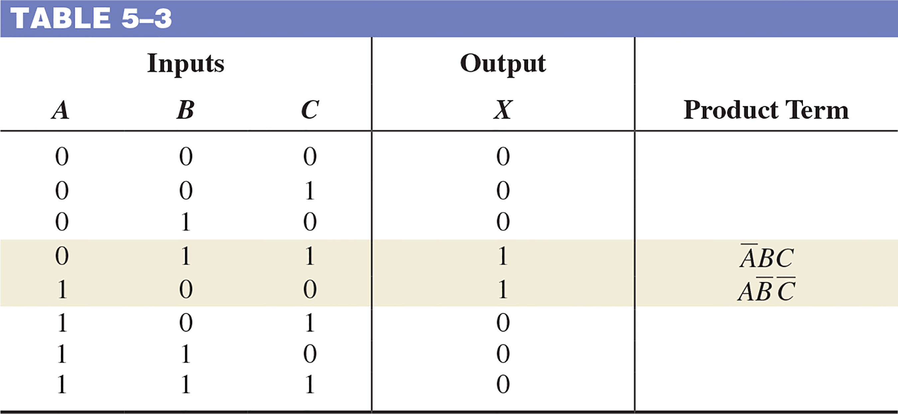
TABLE 5–3
Implementing combinational logic: From a truth table
_______________________________________________

Slide 26
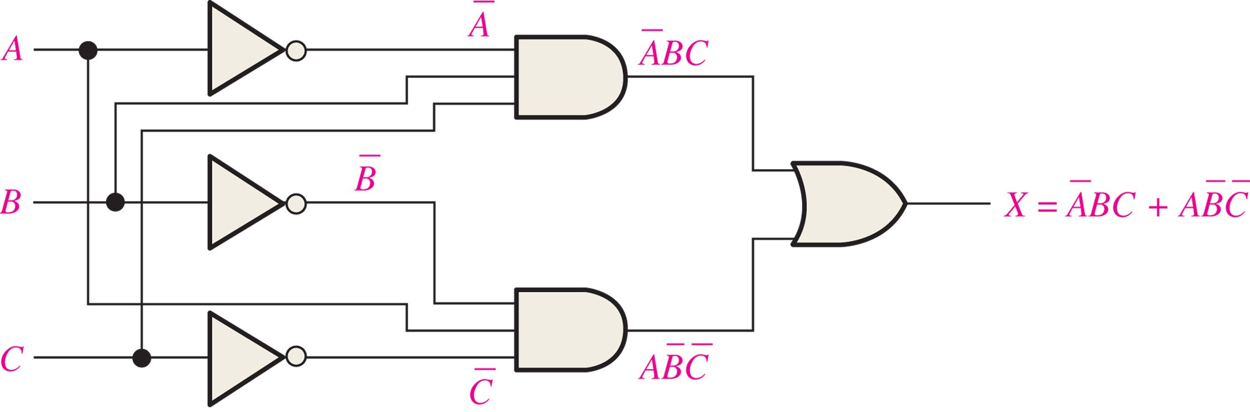
FIGURE 5-11 Logic circuit for X = ĀBC + ABC.

Slide 27
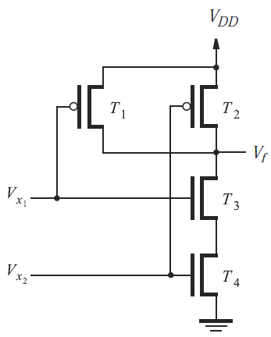
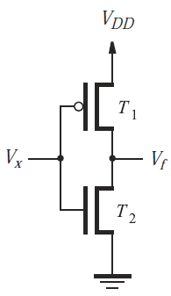
NAND-only and NOR-only circuits
CMOS implementations
  2-input AND/OR gate (6 transistors)
  2-input NAND/NOR gate (4 transistors)
  NOT gate (2 transistors)
NAND NOT

Slide 28
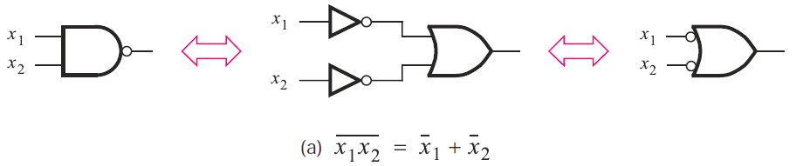
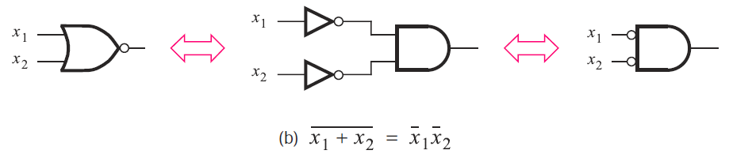
NAND-only and NOR-only circuits
NAND and NOR gates (two symbols)

Slide 29
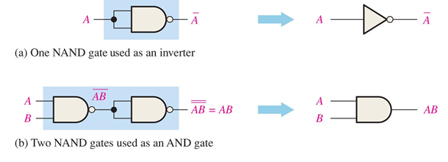
FIGURE 5-18 Universal application of NAND gates.

Slide 30
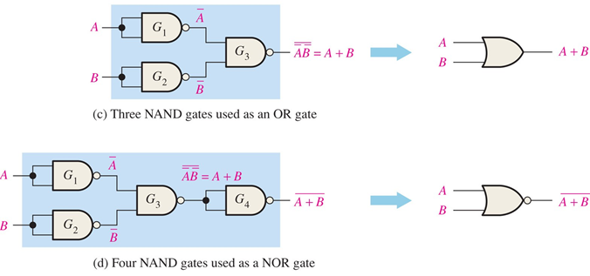
FIGURE 5-18 Universal application of NAND gates.

Slide 31
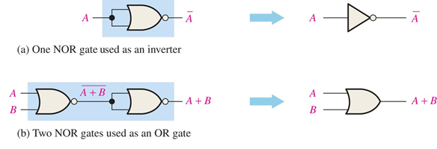
FIGURE 5-19 Universal application of NOR gates.

Slide 32
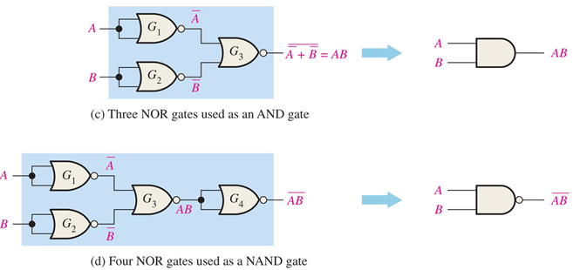
FIGURE 5-19 Universal application of NOR gates.

